Slide 1



Booking.com Web Scraping
Presented by: Pooja Shah

Slide 2
Project Scope:
Information collected by Web Scraping from Booking.com for the city of Lille
Data extracted on monthly basis for a total of 12 months from December 2020 to November 2021
Key variables include:
Hotel/Apartment Name
Location (in Lille)
Total Price in Euros
(for the selected period i.e. month)
Number of nights
Number of persons
Room Type
Beds
Rating
Rating Title
Number of reviews
Distance from city centre
Booking start date
Booking end date
Is breakfast included in the price?
Is free cancellation option applicable?

Slide 3
Project Flow:
Definition of Scope: Based on the information available from Booking.com, I decided that I wanted to focus my analyses on 3 aspects for a duration of 1 year : Availability of accommodation options | Price | Ratings & Reviews
Definition of Goals:
Have a clean usable data
Find relationships between several variables such as price, ratings, services offered, distance from city centre and more
Data collection : After several trial and errors, I succeeded downloading a CSV using Selectorlib
Understanding, Cleaning & Processing: Dropped some nulls for certain analysis, added new columns, converted data types, etc. using Pandas and Numpy mainly
Visualizations: Plotted the graphs using Matplotlib, Seaborn and Plotly
Insights: From the graphs and charts

Slide 4
Challenges:
Web scraping without any knowledge about it
The biggest challenge was to fetch price data for hotels which was crucial for my analysis. With Beautiful Soup I could fetch all other data but not price. Hence I used Selectorlib to collect my final data
Data cleaning and processing took time but was necessary to make data usable

Slide 5
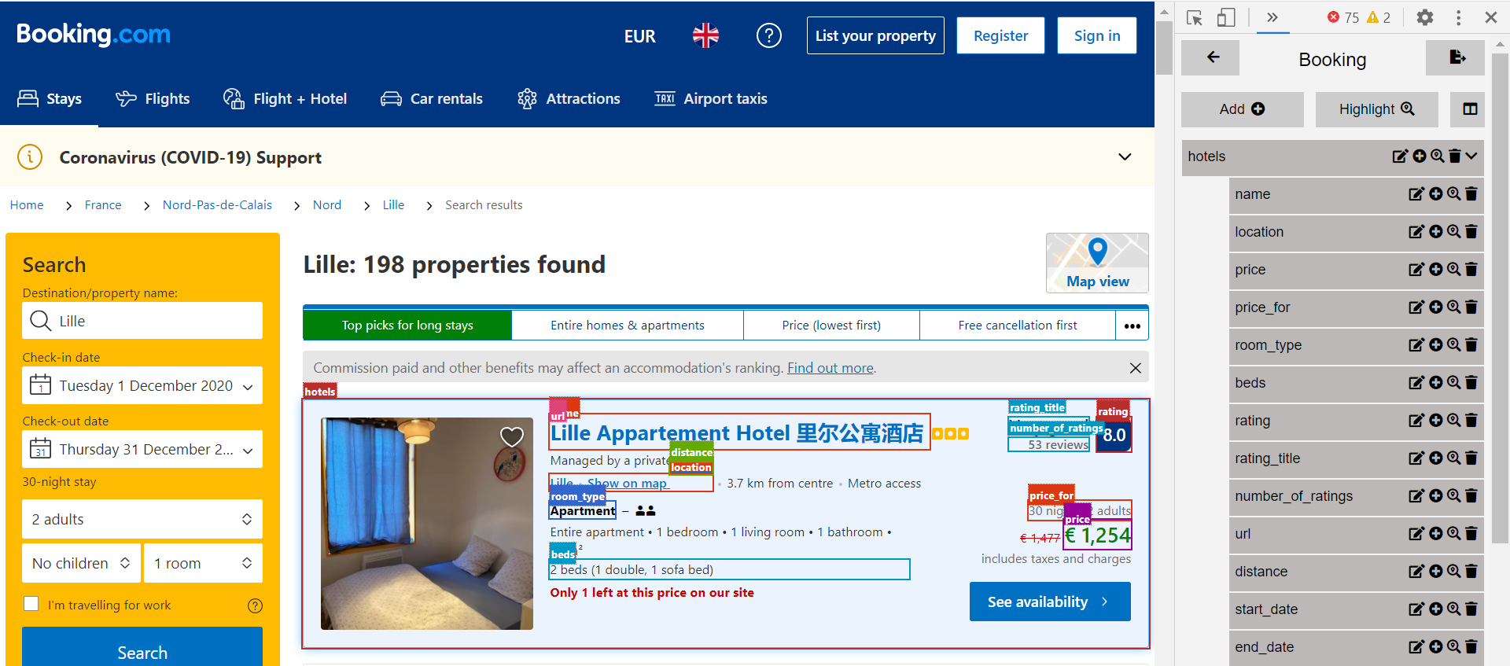

Slide 6
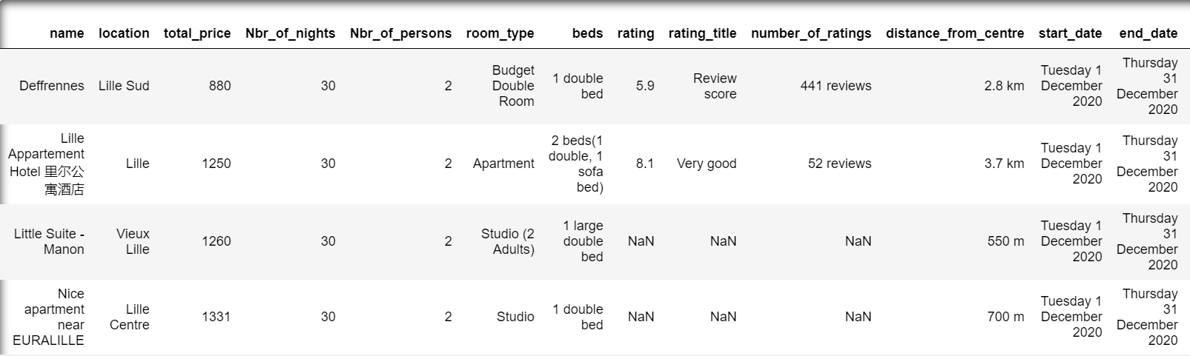
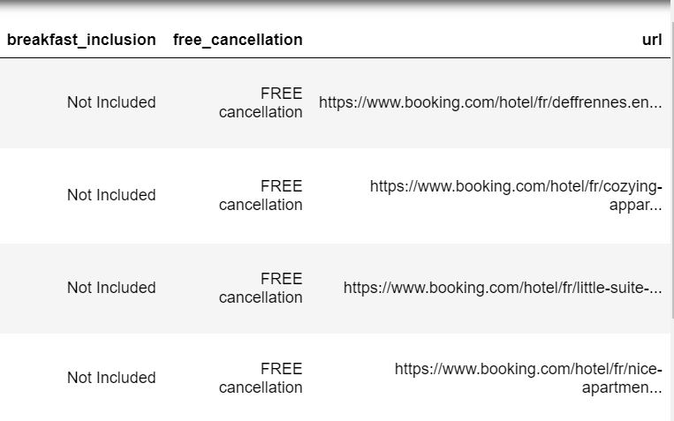
Snapshot of Original Dataframe
2713 rows x 16 columns

Slide 7

Pricing
Availability
Ratings

Slide 8
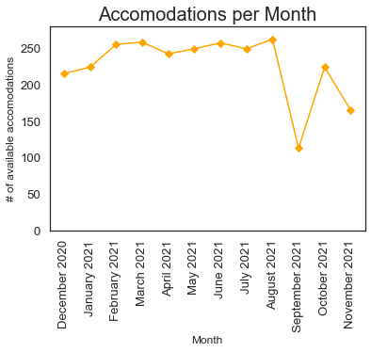
Room Availability
Insights:
There is a sudden drop in the availability of hotels in September. On closer inspection, it is observed that the average is drastically down only during the weekend of 4-5 September which turns out to be the "Braderie de Lille" weekend that attracts 3 million visitors every year.
The drop is thus explained by 2 possibilities:
Many of the hotels have been already booked so much in advance
The hotels have chosen not to make the rooms available yet with hopes of higher prices in future (less likely)

Slide 9
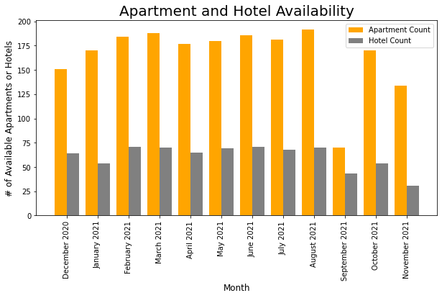
Hotels vs Apartments
Availability:
Hotels < ~2/3rd Apartments
September:
Either apartments are booked faster than hotels
Or apartment owners want to keep their apartment for themselves during “Braderie” weekend

Slide 10
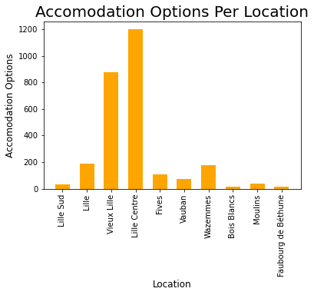
Options by Areas
Insights:
As anticipated, Lille Centre has maximum number of hotels, followed by Vieux Lille in a duration of 12 months

Slide 11
Pricing
Availability
Ratings

Slide 12
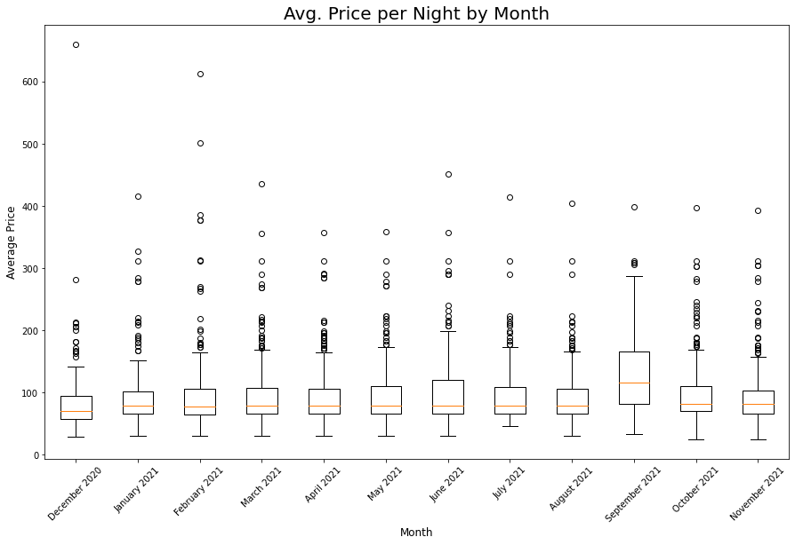
Price Per Night - Month
Insights:
Lower 50% of the hotels have similar or standard price range throughout the year (except Sept.)
The top half of the hotels have varied prices across all months
September (being the festival month) and June (being the summer month) have a larger third quartile possibly because of higher earning scope during those months

Slide 13
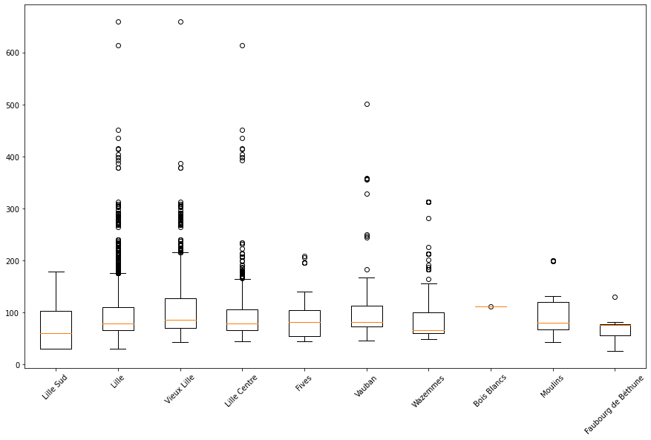
Price Per Area
Insights:
Bois Blancs seems to have only 1 hotel which explains why its median price is higher than all other quartiers
Top 50% of the hotels in Vieux Lille is higher priced compared to top 50% in other locations
Faubourg de Béthune is a low-budget area

Slide 14
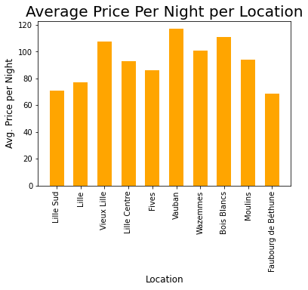
Price Per Area
Insights:
As the previous boxplot suggests, Faubourg de Béthune has lowest hotel prices and Bois Blancs is expensive compared to most others because of a hotel's monopoly in the area
However, while the boxplot gave an impression that possibly Lille Centre and Vieux Lille would be more expensive, it turns out that average price for Vauban is higher than all other areas

Slide 15
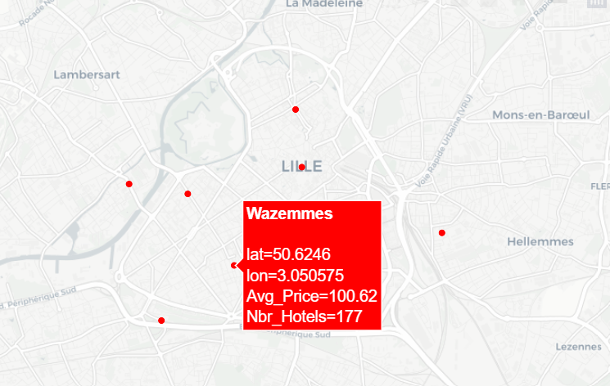
Price Per Area – Map
Geolocation map with hover data with Plotly package

Slide 16
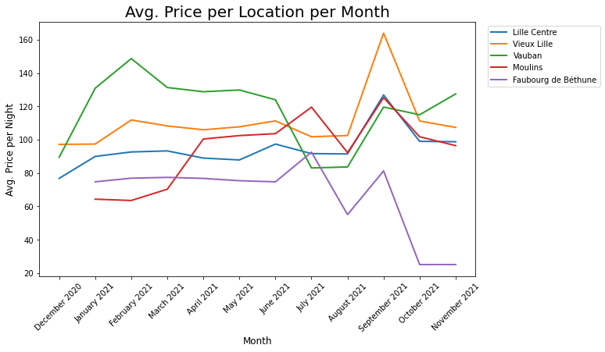
Price Per Area Per Month
Vauban:
January- May, September onwards – High - student area with most universities & colleges
June-August – Low – Students go back home/on vacation during the summer break
Vieux Lille and Lille Centre:
Similar trend as favourite tourist places
Peak in September is explained earlier - Braderie
Faubourg de Béthune :
Low because of its reputation as among the poorest and unsafe areas

Slide 17
Pricing
Availability
Ratings

Slide 18
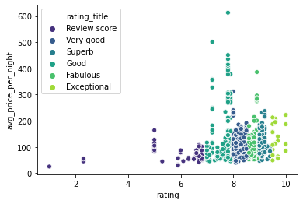
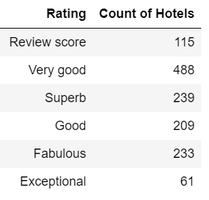
Ratings & Price
Insights:
As the ratings increase there's also a corresponding change in price
The "Very Good" hotels are super bunched up with the highest count of hotels and competitive prices
Most of the high price outliers in the "Good" range are from 2-3 properties in Vieux Lille consistently priced higher than properties in the "Good" range in other locations

Slide 19
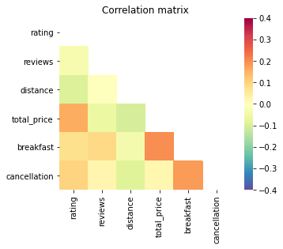
Correlation Matrix – Positive
Insights:
Direct correlation between inclusion of breakfast in the booking and the total price per night
Interesting: Good correlation between 'breakfast' and 'cancellation', meaning that hotels that offer one of these services also tend to offer the other one
Higher the ratings, higher the cost per night
Slight positive correlation between free cancellation service and higher ratings

Slide 20
Correlation Matrix – Negative
As the hotels are closer to the city centre (distance), the ratings on an average are higher
Hotels closer to the city centre are priced higher
Closer the hotel to the centre, more options for free cancellation are available. Possible explanation: These hotels would have more assurance of being occupied even later while far away hotels cannot expect the same

Slide 21
Thank You! Questions?

